Slide 1
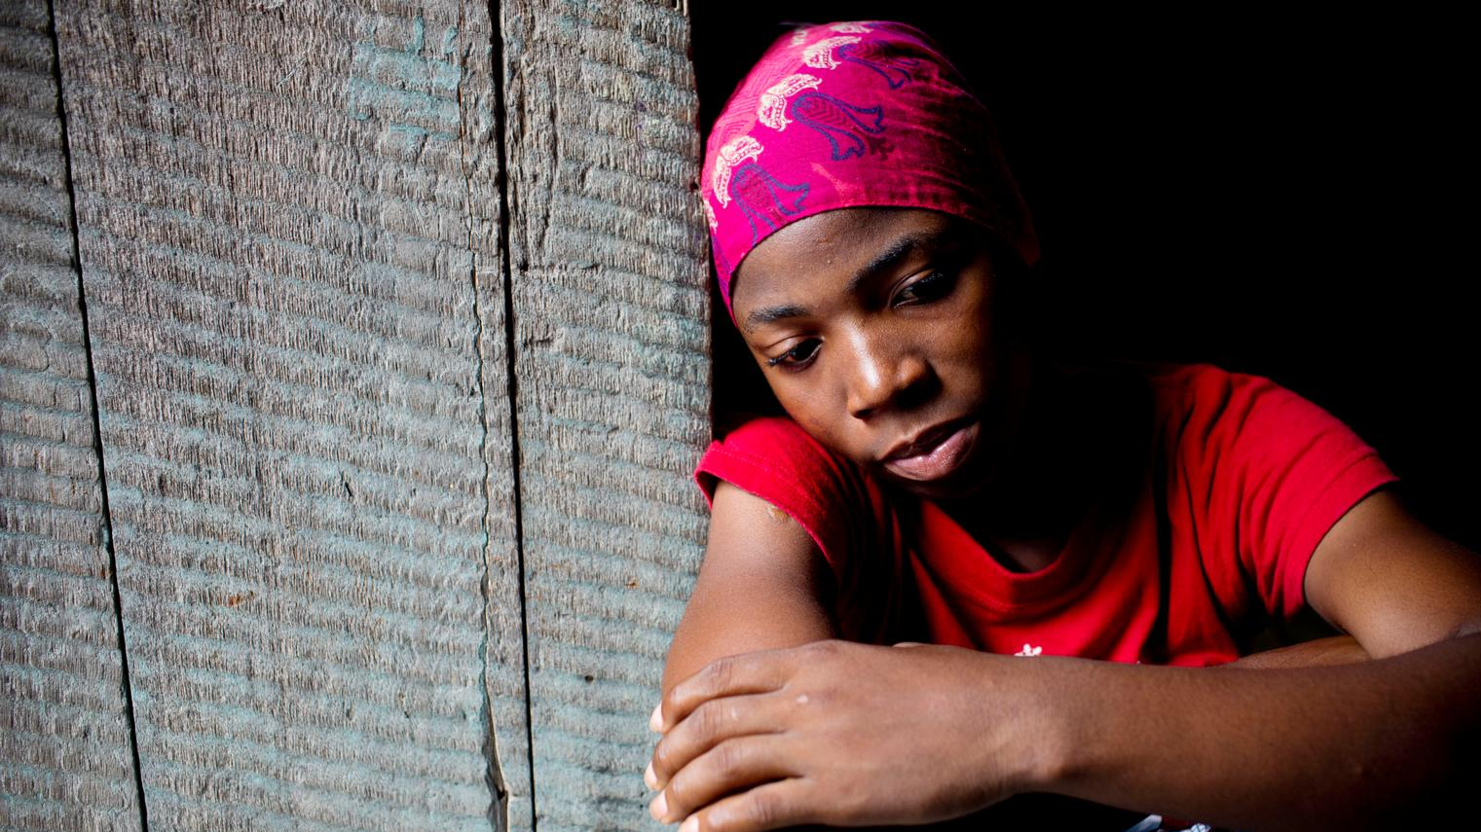
Children & AIDS
Statistical Update 2017

Slide 2
Global targets will not be met
A UNICEF analysis of UNAIDS data suggest that without accelerated action, the 2020 super-fast-track targets for eliminating HIV transmission in children, reducing new HIV infections in adolescent girls and young women, and for increasing HIV treatment in children and adolescents living with HIV will not be met.

Slide 3
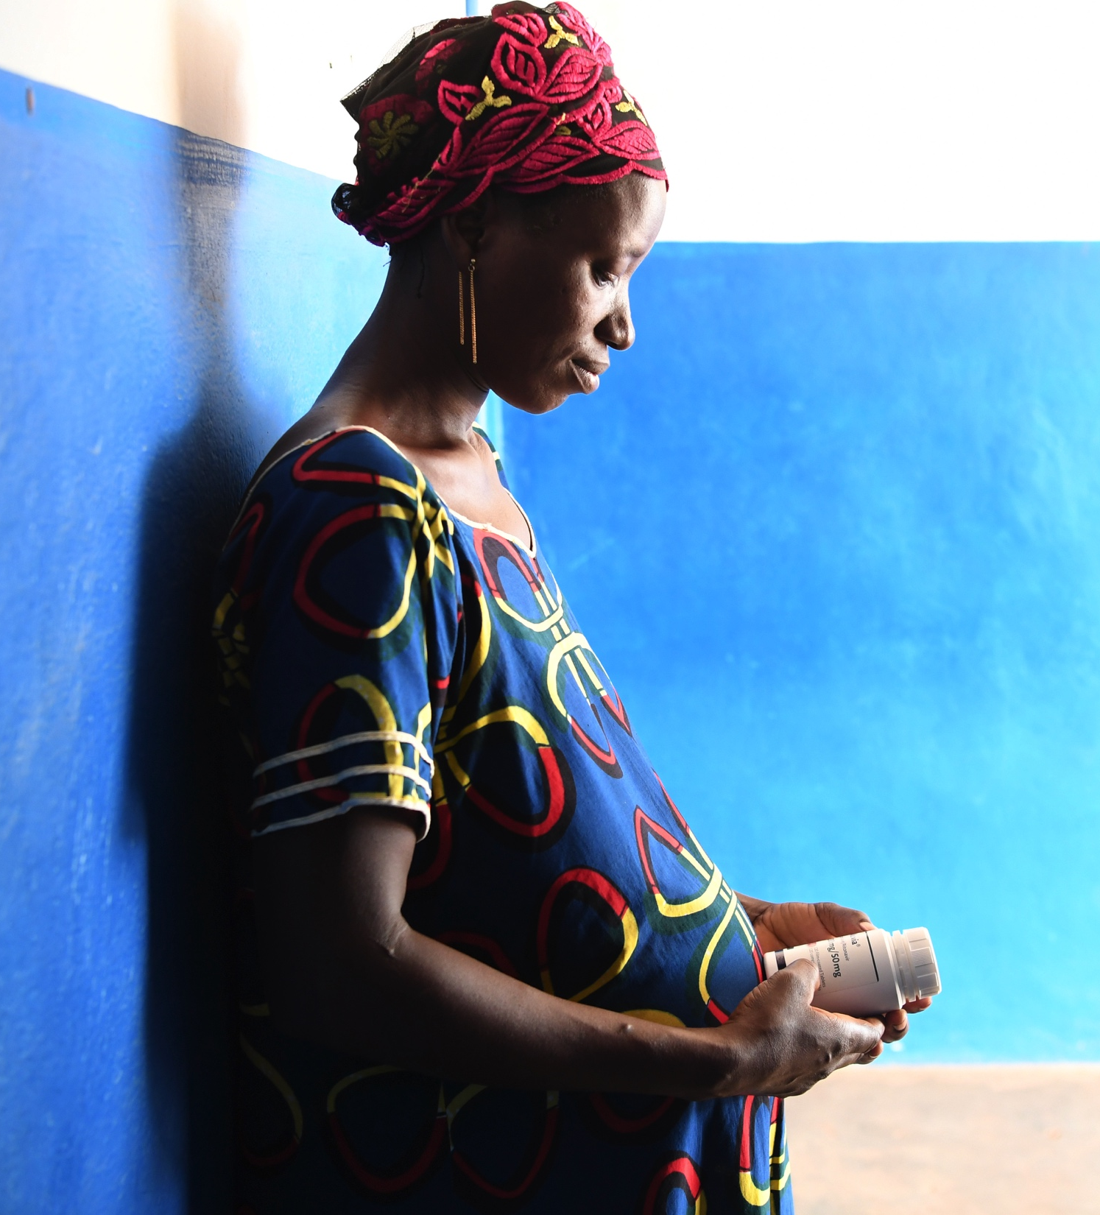
Super-Fast-Track Targets
Eliminate mother-to-child transmission of HIV by reducing the number of children newly infected with HIV to less than 40,000 per year by 2018 and 20,000 by 2020
Reduce the number of new HIV infections among adolescents and young women to fewer than 100,000 per year by 2020
Provide 1.4 million children (aged 0–14 years) and 1 million adolescents (aged 15–19 years) with HIV treatment by 2020
© UNICEF/UN061604/Dejongh

Slide 4
Dramatic shift is needed to meet targets set for children
Trends and projections in the number of new HIV infections among children (aged 0–14) toward the super-fast-track 2020 target
Source info here: UNICEF analysis of UNAIDS 2017 estimates
Note: This chart assumes the super-fast-track target of achieving only 20,000 new infections among children aged 0–14 years globally by 2020. Projections have been calculated by calculating the average annual rate of reduction from 2010–2016 and applying that rate through 2020. Projection trends towards each target assume an average annual rate of increase from 2016 to 2020.
Notes:
UNICEF projects that if the reduction in new paediatric HIV infections continues at the same rate, there will be 100,000 new infections
among children in 2020 alone, as opposed to the 20,000 super-fast-track target.

Slide 5
Global summary of HIV epidemic in women and children (0—14), 2016
Global Summary of HIV Epidemic in Women and Children, 2016
 | Global | Sub-Saharan Africa | % of Global
Estimated number of women (15+) living with HIV | 17,800,000 | 14,100,000 | 79%
Estimated number of pregnant women living with HIV | 1,400,000 | 1,300,000 | 93%
Estimated number of children (<15) living with HIV | 2,100,000 | 1,900,000 | 90%
Estimated number of children (<15) newly infected with HIV | 160,000 | 140,000 | 88%
Estimated number of children (<15) dying of AIDS-related causes | 120,000 | 100,000 | 83%
Source: UNAIDS 2017 estimates.
Notes:
In 2016, 1.4 million pregnant women were living with HIV globally. This amounted to 160,000 new childhood HIV infections. Along the prevention of mother-to-child-transmission cascade, Sub-Saharan Africa accounts for anywhere from 79% to 93% of affected populations.

Slide 6
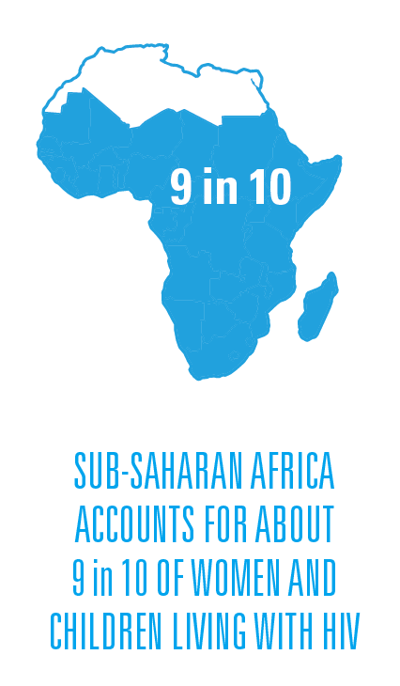
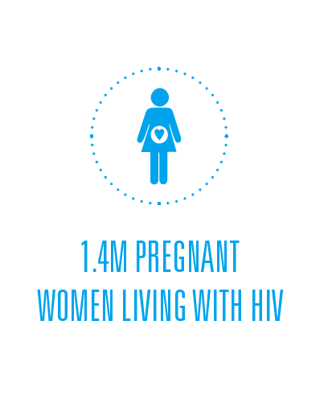
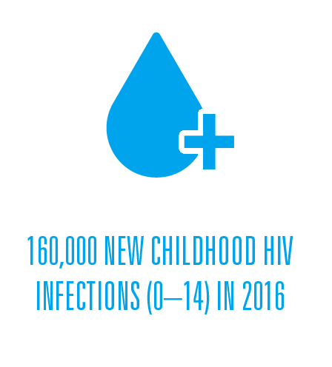
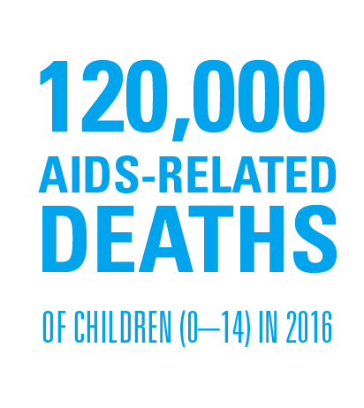

Slide 7
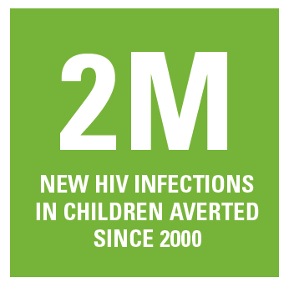
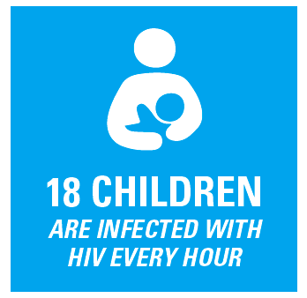
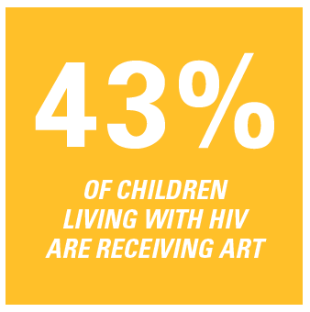

Slide 8
Far from 90-90-90 targets
Percentage of total people living with HIV who know their status, are on ART, and are virally suppressed, by region, 2016
Source: UNAIDS 2017 Estimates
Note: Data for North America not available
Notes:
Globally, 70% of people living with HIV know their status, 53% of people living with HIV are on ART, and 41% of people living with HIV are on ART and virally suppressed. We are far from 90-90-90 targets. Regions that are especially far from meeting 90-90-90 targets include Middle East and North Africa, Eastern Europe and Central Asia, and Western and Central Africa. Despite the high burden of HIV in Eastern and Southern Africa, the region is closer than most to reaching 90-90-90 targets.

Slide 9
PMTCT represents one of the greatest public health achievements in recent times
Percentage of pregnant women living with HIV receiving effective antiretroviral medicines for PMTCT,
by UNICEF regions, 2010-2016
Source: UNAIDS/UNICEF/WHO Global AIDS Response Progress Reporting and UNAIDS 2017 estimates
Notes:
Since 2010, the ARV coverage for pregnant women living with HIV has increased globally. Steeper increases were seen in South Asia (less than 1% to 38%) and in Western and Central Africa (21% to 49%, a 129% increase). East Asia and the Pacific has only increased by 17% since 2010.
The scale-up of prevention of mother-to-child transmission (PMTCT) of HIV services is one of the greatest public health achievements in recent times. Services are increasingly integrated, new ways of delivering those services have been introduced, and antiretroviral treatment to improve maternal health and prevent mother-to-child transmission was accessed by three quarters of all pregnant women living with HIV in 2016. Since 2000, some 2 million new infections in children have been averted – the vast majority of these (1.6 million) since 2010.

Slide 10
Great gains in PMTCT in the most affected regions
Percentage of pregnant women living with HIV receiving effective antiretroviral medicines for PMTCT,
by African geogrpahic region, 2010-2016
Source: UNAIDS/UNICEF/WHO Global AIDS Response Progress Reporting and UNAIDS 2017 estimates
Note: excludes single dose nervirapine.
Notes:
Unlike in paediatric ART coverage, Western and Central Africa are performing higher than Northern Africa with regards to coverage of effective antiretrovial medicines for pregnant women living with HIV.
Western Africa observed a 7% increase in Maternal ARV coverage from since 2015; while Central Africa observed a 4% decrease in Maternal ARV coverage.
Since 2010, Central Africa has observed a 148% increase and Western Africa has observed a 116% increase; the largest per cent increases in Africa.

Slide 11
Wide range in treatment coverage
for high burden countries
Percentage of pregnant women living with HIV receiving most effective ARVs for PMTCT, 23 countries with over 10,000 pregnant women living with HIV, 2016
Source: UNAIDS 2017 estimates
Note: Selected countries include all countries for which data were available and an estimated minimum of 10,000 pregnant women were living with HIV in 2-16; excludes single dose nervirapine.
Notes:
Among countries with over 10,000 pregnant women living with HIV, treatment coverage varies form 14% to over 95%. The high-burden countries with the least coverage are Angola, Nigeria, and Indonesia. Namibia, Uganda, South Africa, Botswana, and Swaziland have all reached 95% PMTCT coverage.

Slide 12
2M new paediatric HIV infections averted by PMTCT
Estimated number of new HIV infections averted by PMTCT programmes (cumulative) globally, 2000-2016
Source: UNICEF analysis of UNAIDS 2017 estimates
Notes:
Through PMTCT programs, we have been able to avert 2 million HIV infections globally since 2000.

Slide 13
Half of new HIV infections among children
occur within 6 weeks of birth
Estimated number of new HIV infections among children (aged 0—14), distributed by postnatal and perinatal infection, global, 2010 and 2016
Source: UNICEF analysis of UNAIDS 2017 estimates
Note: Values may not sum to total due to rounding.
Notes:
Globally, half of new HIV infections among children occur within 6 weeks of birth. While the number of total new infections among children has decreased by 47% since 2010, no change has been observed in the distribution of these infections occurring during perinatal and postnatal periods.

Slide 14
Most children (0-14) living with HIV are in
Eastern and Southern Africa
Estimated number and percentage of children aged 0–14 living with HIV, by UNICEF region, 2016
Source: UNAIDS 2017 estimates
Note: Data not available for Eastern Europe and Central Asia, North America, and Western Europe.
Notes:
Most children living with HIV live in Eastern and Southern Africa (63%) or Western and Central Africa (25%).

Slide 15
Nigeria contributes to a quarter of the world’s new HIV infections among children (0-14)
Estimated number and percentage of new infections among children (aged 0—14), top 10 contributing countries, 2016
Total new HIV infections: 160,000
Source: UNAIDS 2017 estimates
Note: Data not available for India.
Notes:
Nigeria contributes to 23% of the world's new infections among children aged 0-14, and to 21% of the world's AIDS-related deaths among children 0-14.

Slide 16
Nigeria contributes to one fifth of the world’s
AIDS-deaths among children (0-14)
Estimated number and percentage of AIDS-deaths among children (aged 0—14), top 10 contributing countries, 2016
Source: UNAIDS 2017 estimates
Note: Data not available for India.
Notes:
Nigeria contributes to 23% of the world's new infections among children aged 0-14, and to 21% of the world's AIDS-related deaths among children 0-14.

Slide 17
Pediatric treatment coverage too low across all regions
Percentage of children (aged 0—14) living with HIV receiving antiretroviral therapy (ART), by UNICEF region, 2010-2016
Source: UNAIDS 2017 estimates
Note: Data not available for Eastern Europe and Central Asia, North America, and Western Europe.
Notes:
In 2016, pediatric treatment coverage ranged from 21% in Western and Central Africa to 62% on East Asia and the Pacific and Middle East and North Africa.
Western and Central Africa observed the largest percent increase from 2010: coverage rate in 2016 is about 220% higher today than it was in 2010.
The smallest percent increase was observed in Latin America and the Caribbean: pediatric coverage only increased by 22% from 2010 to 2016. In 2016, there were 18,000 children on treatment in Latin America and the Caribbean.
MENA observed a 158% increase in pediatric treatment coverage, but this reflects an increase in the number of children on treatment from 1,600 to 1,900.

Slide 18
West and Central Africa lag behind
other African regions in paediatric ART coverage
Percentage of children (aged 0—14) living with HIV receiving antiretroviral therapy (ART),
by African geographic region, 2010-2016
Source: UNAIDS/UNICEF/WHO Global AIDS Response Progress Reporting and UNAIDS 2017 estimates
Notes:
Western and Central Africa are performing about the same with regards to pediatric treatment coverage, but both are performing lower than other African regions.
Western Africa observed a 26% increase in pediatric ART coverage from since 2015; the largest per cent increase in Africa.
Since 2010, Central Africa has observed a 230% increase and Western Africa has observed a 208% increase.

Slide 19
Less than half of HIV-exposed babies were tested for HIV within 2 months of life
Percentage of infants born to pregnant women living with HIV receiving a virological test for HIV within 2 months of birth (early infant diagnosis), by UNICEF region, 2016
Source: UNAIDS/UNICEF/WHO Global AIDS Response Reporting and UNAIDS 2017 estimates
Note: Data not available for North America. In Western Europe, 13 of 28 countries reported early infant diagnosis.
Notes:
In 2016, 43% of infants born to pregnant women living with HIV received a virologicla test for HIV within 2 months of birth. This means an estimated 610,000 infants received early infant diagnosis for HIV. 510,000 of these infants who received early infant diagnosis are in Eastern & Southern Africa.
Coverage of early infant diagnosis is highest in Eastern and Southern Africa and in Eastern Europe and Central Asia.

Slide 20
Global summary of HIV epidemic among adolescents (10–19), 2016
 | Global |  |  | Sub-Saharan Africa
 | Total | Female | Male | (% of Global)
Estimated number of adolescents 10-19 living with HIV | 2,100,000 | 1,200,000 | 900,000 | 84%
Estimated number of adolescents 15-19 newly infected with HIV | 260,000 | 170,000 | 86,000 | 73%
Estimated number of adolescents 10-19 dying of AIDS-related causes | 55,000 | 26,000 | 29,000 | 91%
Notes:
In 2016, 1.4 million pregnant women were living with HIV globally. This amounted to 160,000 new childhood HIV infections. Along the prevention of mother-to-child-transmission cascade, Sub-Saharan Africa accounts for anywhere from 79% to 93% of affected populations.

Slide 21
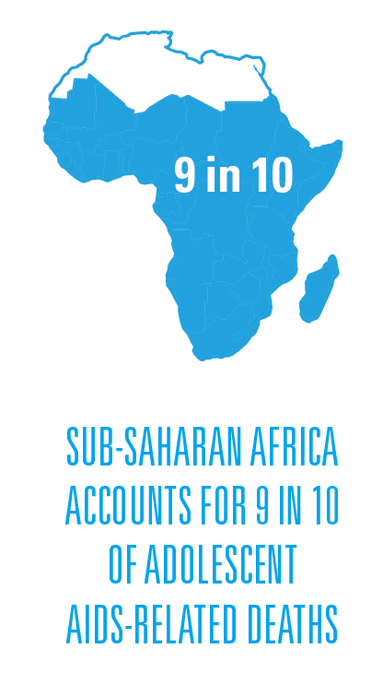
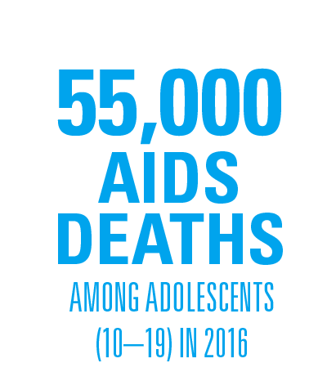
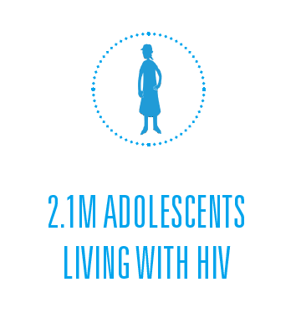
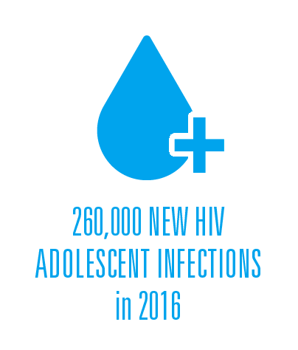

Slide 22
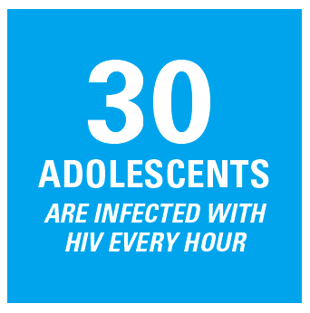
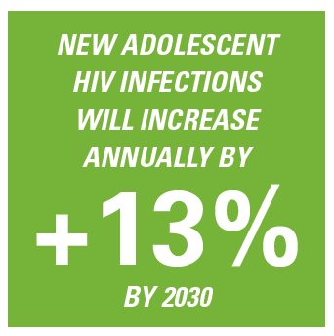

Slide 23
HIV risk related to gender changes throughout the life course of the child
Estimated number of children, adolescents and youth living with HIV, global, 2016
Source: UNAIDS 2017 estimates
.
Notes:
In Sub-Saharan Africa, girls and young women are more affected by HIV than boys and young men. While the distribution of children 0-14 living with HIV is even, gender disparities emerge in adolescence. Among adolescent 10-19 living with with HIV in SSA, 58% are girls. This means for every 5 adolescent boys living with HIV in SSA, there are 7 girls living with HIV in SSA.
This gender disparity grows in older age groups: among youth aged 20-24 living with HIV, 67% are young women. This means that for every 5 young men living with HIV in SSA, there are 10 young women living with HIV.
The rest of the world experiences different gender patterns among adolescents, and youth living with HIV. Among adolescents 10-19 living with HIV in all other regions besides SSA, 53% are boys. This means that for every 5 adolescent girls living with HIV there are 6 adolescent boys living with HIV in regions outside of SSA.
This gender disparity grows in older age groups: among youth aged 20-24 living with HIV, 58% are young men. This means that for every 5 young women living with HIV there are 7 young men living with HIV in regions outside of SSA.

Slide 24
New HIV infections among adolescents 15-19 not decreasing as quickly as among children 0–14
Adolescents 15-19
Children
0-14
Source: UNAIDS 2017 estimates
Notes:
The great success we have seen in preventing mother-to-child transmission of HIV – which has resulted in 2 million infections averted among children since 2000 represents a remarkable public health achievement.
But that same progress is not the same for the adolescent population. In fact, for the first time, in 2010, the number of new HIV infections among adolescents surpassed that of the number of new infections in children. In 2016, adolescent new infections were 62% higher than the number of new infections in children. The number of new infections among adolescents in 2016 has only decreased by 14% since 2010 (compared to 47% reduction in children).

Slide 25
Sub-Saharan Africa is carrying the burden of the HIV epidemic among adolescents(10-19) living with HIV
Source: UNAIDS 2017 estimates
Note: Data not available for Eastern Europe and Central Asia, North America, and Western Europe.
Notes:
The majority of these 2.1 million adolescents living with HIV, reside in sub Saharan Africa which continues to carry the burden of the HIV epidemic.
About 63% of the world's adolescents living with HIV live in Eastern and Southern Africa.
About 85% of the world's adolescents living with HIV live in Sub-Saharan Africa.

Slide 26
Estimated number and percentage of new HIV infections among adolescents aged 15–19, by UNICEF regions, 2016
Source: UNAIDS 2017 estimates
Note: Data not available for North America
Notes:
Almost half of the world's new HIV infections among adolescents occurred in Eastern and Southern Africa.
About 73% of new adolescent HIV infections occurred in Sub-Saharan Africa.

Slide 27
Glacial pace for annual rate of reduction of new adolescent HIV infections
Estimated number of new HIV infections among adolescents aged 15-19, by sex, 2010-2016
Source: UNAIDS/UNICEF/WHO Global AIDS Response Progress Reporting and UNAIDS 2017 estimates
Notes:
Overall, the number of new infections among adolescents 15-19 has been decreasing since 2010 by an average annual rate of 2.4%. Among girls, this average annual rate of reduction is 2.6%. Among boys, this average annual rate of reduction is 2.2%.
It is important to note that although new infections are decreasing steadily in both populations, girls have always been more affected. In every year since 2010, 67% of new adolescent infections are in girls.

Slide 28
Dramatic shift is needed to meet global targets set for adolescent girls and young women
Trends and projections in the number of new HIV infections among adolescent girls and young women (aged 15—19)
toward the super-fast-track 2020 target
Source: UNICEF analysis of UNAIDS 2017 estimates
Note: This chart assumes the super-fast-track target of achieving only 100,000 new infections among adolescent girls and young women globally by 2020. Projections have been calculated by calculating the average annual rate of reduction from 2010–2016 and applying that rate through 2020. Projection trends towards each target assume an average annual rate of increase from 2016 to 2020.

Slide 29
Without immediate action,
adolescent HIV infections will rise
Estimated number of new HIV infections among adolescents (15—19 years), 2000-2016 with 2016-2030 projections
Source: UNICEF analysis of UNAIDS 2017 estimates, July 2017
Notes:
The demographic transition and "youth bulge" will have an impact on the number of new HIV infections we will see among adolescents 15-19. Without immediate action, we will get further and further away from 2030 targets.
New infections among adolescents are expected to increase by 13%, leaving us over 8000% higher than the 2030 target for new infections among adolescents.
If we stay on the current trajectory, we will see 3.5 million new adolescent infections between 2017 and 2030. If we get on track to meet 2030 targets, we could see just 700,000 between 2017 and 2030.

Slide 30
Gender plays an important role
in determining HIV risk among adolescents
Estimated distribution of new HIV infections among adolescents aged 15-19, by sex, UNICEF region, 2016
Source: UNAIDS/UNICEF/WHO Global AIDS Response Progress Reporting and UNAIDS 2017 estimates
Note: Data not available for North America
Notes:
In sub-Saharan Africa, adolescent girls continue to be at great risk of infection. But the distribution of new HIV infection among this population group varies greatly across regions by sex.
Outside of sub-Saharan Africa, and Eastern Europe, over 50% of new adolescent HIV infections were in boys – primarily from key populations.

Slide 31
Fewer adolescent girls AIDS-deaths than boys
Estimated number of AIDS-related deaths among adolescents aged 10—19, by sex, 2010-2016
Source: UNAIDS/UNICEF/WHO Global AIDS Response Progress Reporting and UNAIDS 2017 estimates
Notes:
Overall, the number of AIDS-related deaths among adolescents 10-19 has decreased since 2010 by 5.3%. Among girls, the number of AIDS-related deaths has decreased by 10.8% while the number of AIDS-related deaths among boys has increased by 0.2% since 2010.
About 53% of the AIDS-related deaths among adolescents 10-19 in 2016 occurred in boys.

Slide 32
AIDS-related deaths among adolescents
are not decreasing
Estimated number of AIDS-related deaths, by 10-year age groups, 2010-2016
Source: UNAIDS 2017 estimates
Notes:
As a result, since 2010, AIDS-related deaths among adolescents 10-19 have only reduced by 5%. This is shocking compared to, e.g. AIDS-related deaths among children 0-9 which have reduced by 50%.
While we have seen great progress in early childhood survival, little progress has been observed in adolescence.

Slide 33
Two-thirds of adolescent AIDS deaths are in Eastern and Southern Africa
Estimated number and percentage of AIDS-related deaths among adolescents aged 10—19),
by UNICEF region, 2016
Source: UNAIDS 2017 estimates
Note: Data not available for Eastern Europe and Central Asia, North America, and Western Europe.
Notes:
About 61% of the world's AIDS-related deaths among adolescents occurred in Eastern and Southern Africa.

Slide 34
Most adolescents are not accessing lifesaving antiretroviral therapy
Percentage of adolescents (aged 10—19) living with HIV who are receiving ART, 41 countries reporting by UNICEF regions, 2016
Source: UNAIDS/UNICEF/WHO Global AIDS Response Progress Reporting and UNAIDS 2017 estimates
Note: Global reporting of ART numbers by 5-year age group began in 2014 and not all countries are yet able to report ART numbers disaggregated to this level of age specificity. As a result, the values above represent 67 countries that were able to report adolescent ART data for 2015 (either full-year or first 6 months). These 67 countries account for 16% of all adolescents (aged 10—19) living with HIV globally.
Notes:
Of the 41 countries that contributed treatment coverage data for adolescents aged 10-19, a median of 36% of adolescents living with HIV received ART in 2016.
One third of the countries that were able to report on adolescent ART coverage are in Latin America and the Carribean.
In both WCA and LAC, adolescent ART coverage estimates do not exceed 61% in any country.

Slide 35
16.5 million children have lost one or both
parents to AIDS
Estimated number of children (ages 0—17) who have lost one or both parents to an AIDS-related cause,
by UNICEF regions, 1990-2016
Source: UNAIDS 2017 estimates
Notes:
An estimated 16.5 million children have lost one or both parents to an AIDS-related cause. This number has decreased by 16% since 2010. The largest proportion of orphans live in Eastern and Southern Africa.

Slide 36
Room for dramatic improvement:
knowledge, condom use and HIV testing
Selected indicator coverage among adolescent boys and girls (aged 15—19), Sub-Saharan Africa, 2010-2016
Source: UNICEF analysis of DHS, MICS, and other national household surveys, 2010-2016
Note: Regional summaries are only available for regions in which at least 50% of the population is represented in surveys from 2011 to 2016; East Asia and Pacific estimates include China; South Asia estimates include India
Notes:
Across the four regions with available data, comprehensive knowledge among adolescents varies from 8% to 36% in boys and 6% to 35% in girls. The gender differences for comprehensive knowledge are different in each region - unlike in other regions, girls in East Asia and Pacific are more likely to have comprehensive knowledge about HIV than boys.
In Sub-Saharan Africa, HIV testing coverage is higher in Eastern and Southern Africa than in Western and Central Africa: 433% higher in boys and 300% higher in girls. Condom use among adolescent boys is also 26% higher in Eastern and Southern Africa than in Western and Central Africa.
Note that it is difficult to draw any global conclusions from these data, as these surveys are not implemented in every country, or in the same 5-year period. These regions were the only regions in which we could calculate an overall value because the survey data covered a significant portion of the region's population.

Slide 37
Adolescents still lack knowledge, are not using condoms and are not accessing HIV testing
Selected indicator coverage among adolescent boys and girls (aged 15—19), Sub-Saharan Africa, 2010-2016
Source: UNICEF analysis of DHS, MICS, and other national household surveys, 2010-2016
Note: Regional summaries are only available for regions in which at least 50% of the population is represented in surveys from 2011 to 2016;

Slide 38
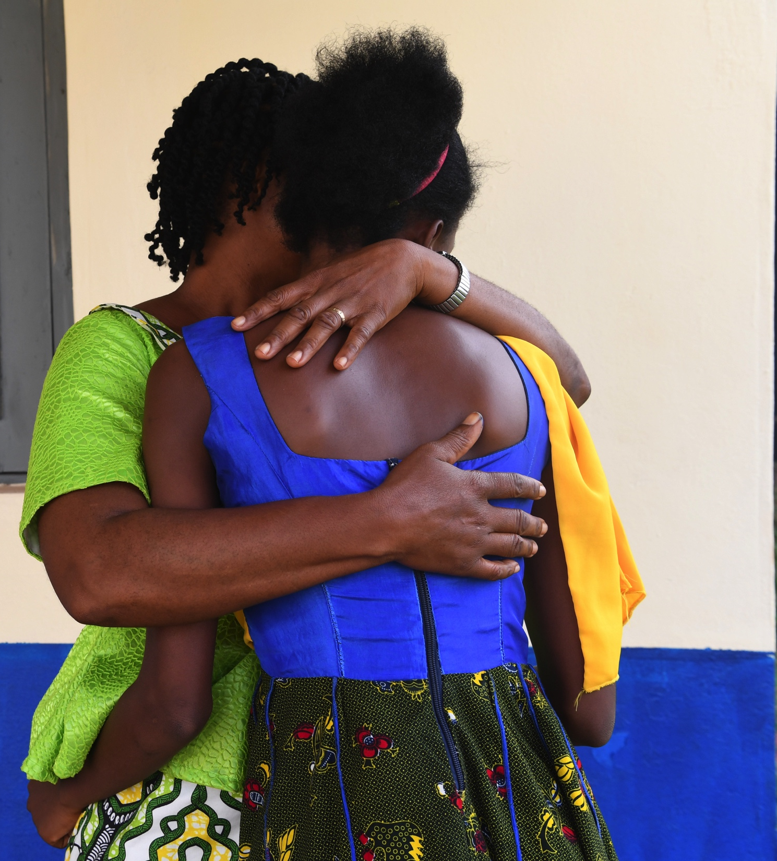
The outlook for hundreds of thousands of children and adolescents is bleak.
In 2016, the world committed once again to bold targets for women, children and adolescents at risk of and/or living with HIV. And today, new tools exist that could make this possible; much evidence and knowledge has been gained, and resources, though scarcer, remain available.
How the world comes together in the next 36 months to finally address the needs of the forgotten populations of children and adolescents will be a major driver of the success in putting an end to AIDS.
© UNICEF/UN061625/Dejongh

Slide 39
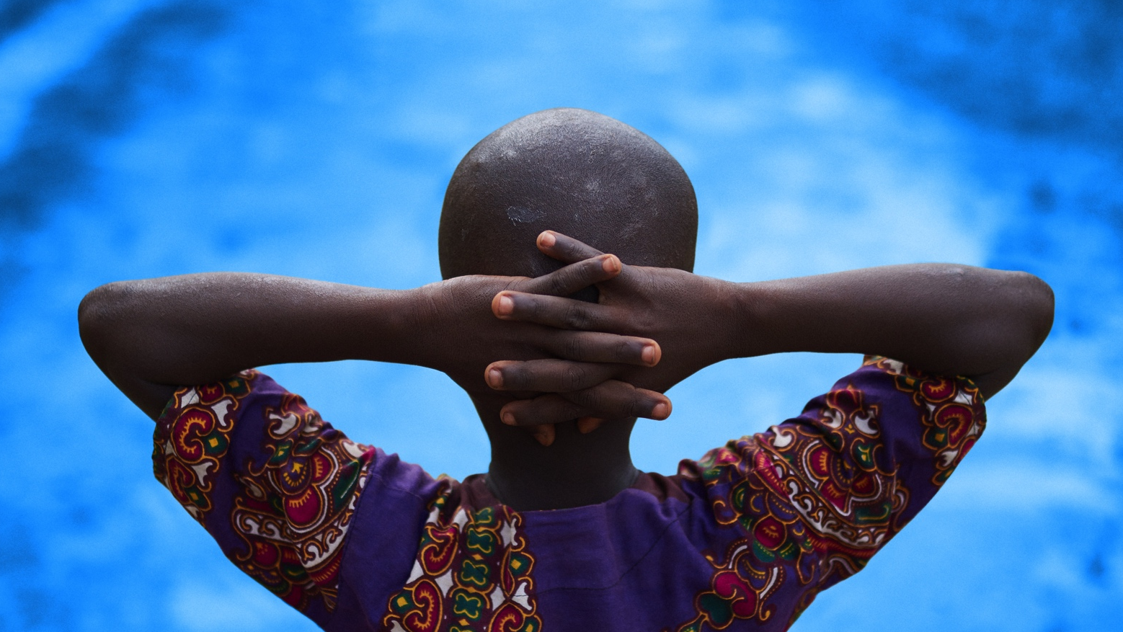
Thank you

